Slide 1
VUID Toolkit 2.1
Phil Shinn
philshinn@yahoo.com
Notes:
1/30/2017
1
1

Slide 2
VTK 1.0 History
VTK 1.0 Free and open source
Placed in public domain 2007
Visio custom object library for VUI design
VB Macros exported prompt list and grammar list to excel
Hand built test cases, Python scripts rebuilt test suite with prompts
Many have extended the concept and built interesting and useful tools
VTK 2.0 is the next evolution
Notes:
1/30/2017
2
2

Slide 3
VTK 2.0 - GUI DrawIO
No More VISIO – VTK GUI runs in DrawIO
Online or desktop diagram flowchart maker
Save to Google Drive or local device
Enables flowcharts, org charts, wireframes, UML, mind maps
Uses the Google Drive Real Time collaboration functionality,
multiple users can work on the same diagram simultaneously
Library of custom shapes implements standard VUI objects
User export the data of these objects to XML file
XML graph imported into VTK Python code
Notes:
1/30/2017
3
3

Slide 4
VTK 2.0 – Python Code
Python code is fully extensible
Object Oriented code imports design XMl graph
Like 1.0, Code exports grammar list and prompt list
But wait it also
Executes application interactively in text mode: WoZ!!
Outputs simulations as all paths through the graph in order to provide user journeys for client review
Outputs simulations in Cyara XML format, automatically creating regression suites
Saves all interactions for further analysis
Does anything else you would like to develop
Notes:
1/30/2017
4
4

Slide 5
VTK 2.0 – Requirements
GUI:
Chrome
DrawIO
Python Code
Python 2.7
Tested on
Mac OSX
Windows 7 & 8
Debian Linux
Download From:
https://sites.google.com/site/ivrdesigngroup/vuid-toolkit
Notes:
1/30/2017
5
5

Slide 6
VTK 2.1 – Slack Integration
Slack is a messaging app for teams
It’s free to try out as long as you want, but there are premium versions that have other features that a company might want
A really cool feature is they support creating bots
Integrating VTK as a bot with slack allows you to communicate with a VTK app over http, by typing into either a browser or into the slack app you can download to a smart phone
Notes:
1/30/2017
6
6

Slide 7
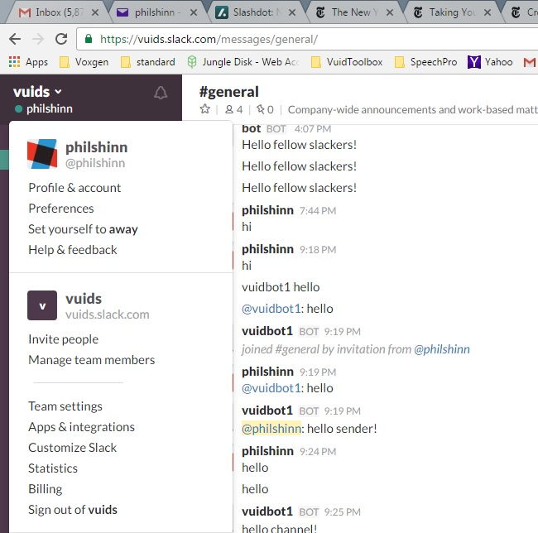

Slide 8
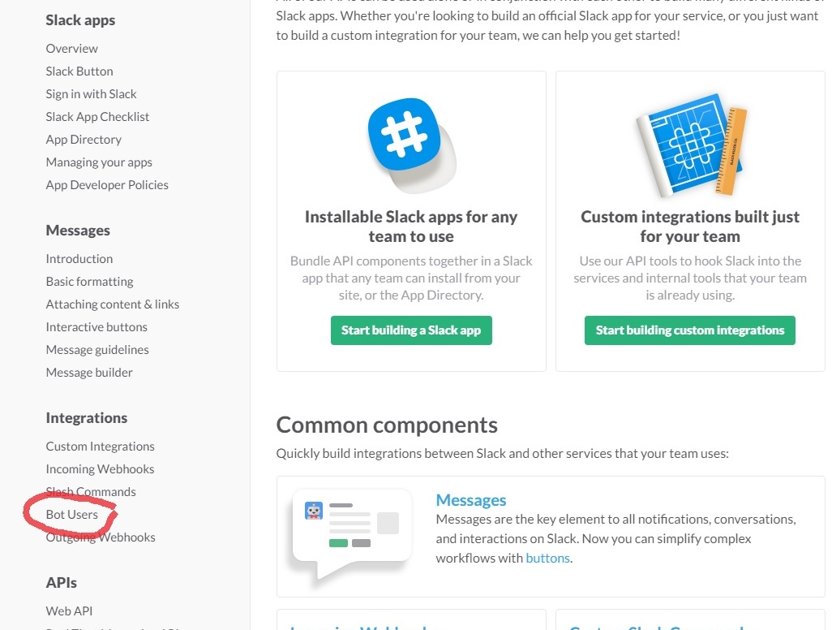

Slide 9
